Slide 1
Student Digital Portfolio
STUDENT NAME: S.Jagadeesh
REGISTER NO AND NMID: 2401111058216/asunm1112401111058216
DEPARTMENT: Bsc Computer Science
COLLEGE: Loganatha narayana samy government college university of madras

Slide 2
PROJECT TITLE
Student Digital Portfolio FWD

Slide 3


AGENDA
Problem Statement
Project Overview
End Users
Tools and Technologies
Portfolio design and Layout
Features and Functionality
Results and Screenshots
Conclusion
Github Link
3/21/2024 Annual Review

Slide 4

PROBLEM STATEMENT
Traditional resumes often fail to demonstrate creativity, verified certifications, and interactive skills. Students and job seekers need a professional digital presence to showcase their talents effectively to recruiters and institutions.

Slide 5

PROJECT OVERVIEW
This project is a personal portfolio website for S.Jagadeesh , a BSc Computer Science student at L.N.G College. It highlights his academic background, technical skills, IBM certifications, and contact details in a modern, responsive, and visually appealing format.

Slide 6

WHO ARE THE END USERS?
Recruiters & Employers To evaluate skills and certifications. Academic Institutions To assess academic and professional growth. Peers & Tech Community For networking and collaboration.

Slide 7

TOOLS AND TECHNIQUES
Frontend: HTML5, CSS3 Styling & Effects: CSS Animations, Gradients, Transitions Responsive Design: Media Queries (for mobile & tablet views) Hosting: GitHub Pages / Netlify

Slide 8
POTFOLIO DESIGN AND LAYOUT
Header: Animated profile initials, name, and title. About Me: Short biography with career focus. Skills Section: Grid-based cards for Web Development, Al, Programming. and Communication. Certifications: IBM digital badges with verification links. Footer: Contact details (Email, College, Course) with an elegant design.
8

Slide 9
FEATURES AND FUNCTIONALITY
Fully responsive design across devices. Animated gradient background & hover effects. Interactive skills and certification cards. Direct verification links for IBM certifications. Smooth Ul with a professional dark theme.

Slide 10
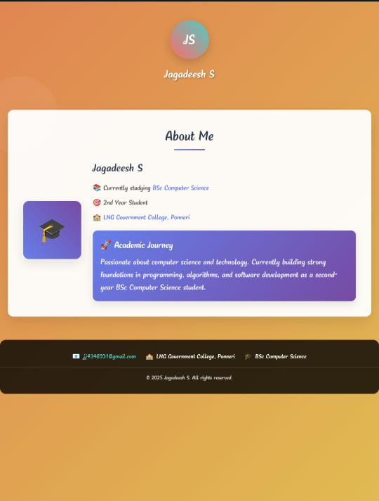

RESULTS AND SCREENSHOTS
3/21/2024 Annual Review
10

Slide 11
CONCLUSION
The portfolio website provides S.Jagadeesh with a strong digital identity. It demonstrates both technical skills and professional achievements, helping recruiters, institutions, and peers quickly evaluate his profile.
11

